Slide 1
CLIENT PROJECT
SUPPLY CHAIN ANALYSIS
TEAM ID: PTID-CDA-OCT-25-803
PROJECT ID: CDACL-003-SUPPLY CHAIN ANALYSIS
TEAM MEMBERS:
ADITYA HINGRAJIYA
AKSHAR PANCHAL
MEDHAKSHI PANDYA

Slide 2
INTRODUCTION
Supply Chain Analysis involves the systematic evaluation of material, information, and financial flows across business operations to improve efficiency, service reliability, and cost effectiveness. In a competitive and customer centric marketplace, agile and data-guided supply chains have become a strategic necessity for sustaining business performance. An optimized supply chain improves product availability, enhances customer satisfaction, and reduces operational waste while controlling end-to-end costs.
Modern organizations increasingly rely on analytics to gain visibility into supply chain performance and identify operational bottlenecks, inefficiencies, and cost drivers. This project applies analytical techniques to assess supply chain performance across core functional areas, support informed decision making, and identify improvement opportunities that strengthen overall business outcomes.

Slide 3
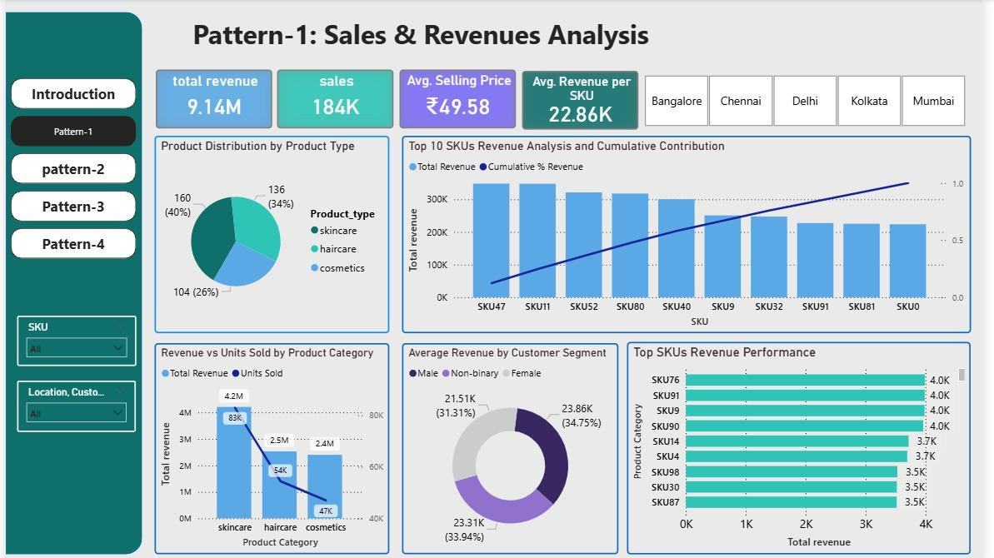
PATTERN-1: SALES & REVENUE ANALYSIS
Skincare is the primary revenue and volume driver, reflecting strong product–market fit and sustained customer demand.
Revenue is highly concentrated in a small number of top-performing SKUs, creating dependency risk and portfolio imbalance.
Cosmetics underperforms on both revenue and sales volume, indicating product mix gaps and untapped growth potential.

Slide 4
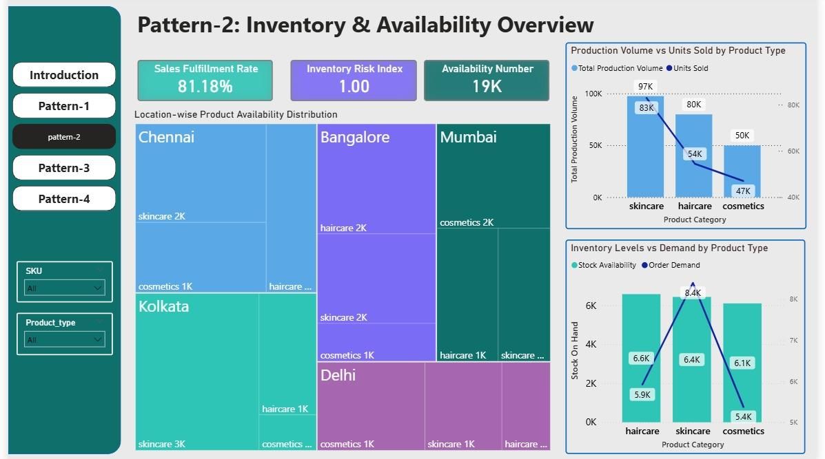
PATTERN-2: INVENTORY & AVAILABILITY OVERVIEW
The sales fulfillment rate of ~81% indicates service gaps and an inability to fully meet customer demand.
Skincare shows higher demand than available stock across locations, creating stockout risk and potential revenue loss.
Haircare and cosmetics maintain relatively higher stock levels despite lower demand, indicating overstocking and inefficient capital deployment.

Slide 5
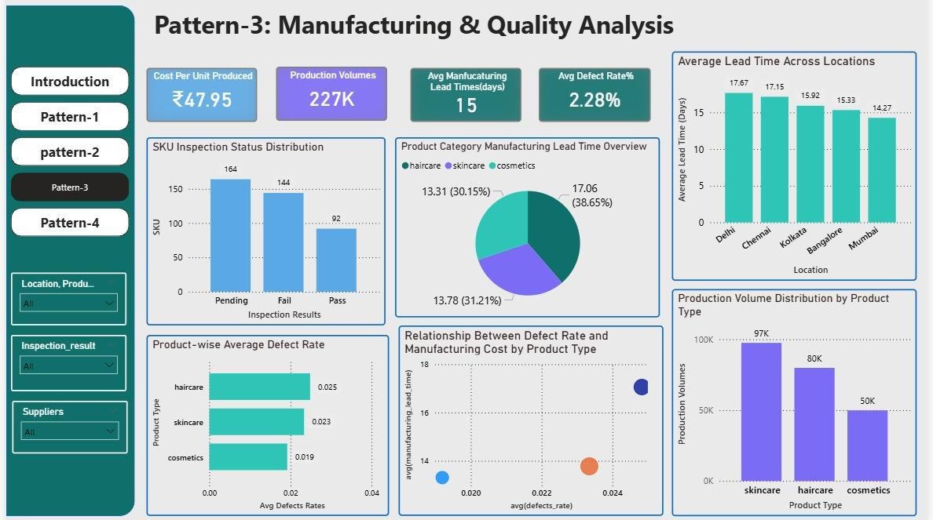
PATTERN-3: MANUFACTURING & QUALITY ANALYSIS
Skincare has the highest production volume, aligning with its strong sales performance and reinforcing its role as the primary demand driver.
Haircare exhibits the highest defect rate and longer manufacturing lead times, indicating quality inefficiencies and higher production costs.
A high volume of pending and failed inspections creates production delays, reducing effective output and impacting downstream supply reliability.

Slide 6
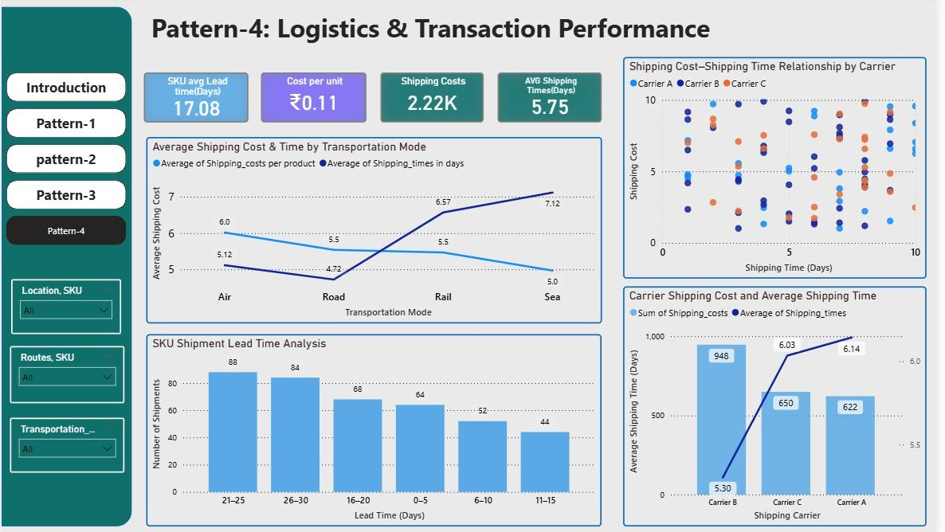
PATTERN-4: LOGISTICS & TRANSACTION PERFORMANCE
Average SKU lead times are relatively high, indicating delays in order fulfillment and reduced service responsiveness.
Sea and rail offer lower shipping costs but significantly longer transit times, while air provides speed at a substantially higher cost, reflecting a clear cost–time trade-off.
Carrier-level performance shows cost and lead-time imbalances, highlighting inefficiencies in carrier selection and route optimization.

Slide 7
The analysis reveals a clear demand–supply disconnect, where high-demand products such as skin care are not adequately supported by inventory and production capacity, resulting in stockouts and lost revenue opportunities, while slower-moving categories remain overstocked.
Quality inefficiencies and inspection backlogs further constrain effective supply by reducing usable inventory and increasing manufacturing lead times, weakening the organization’s ability to meet market demand consistently.
These upstream inefficiencies are compounded by logistics delays and suboptimal cost–time trade-offs, which extend order fulfillment cycles and limit service responsiveness, ultimately impacting customer experience and revenue realization.
CROSS-PATTERN BUSINESS INSIGHTS

Slide 8
BUSINESS RECOMMENDATIONS
Implement demand-driven inventory allocation to rebalance stock toward high-velocity SKUs and high-demand locations, reducing stockouts and revenue leakage.
Introduce sales-synchronized replenishment planning to align inventory cycles with actual demand trends, improving turnover and releasing tied-up working capital.
Realign manufacturing output with demand signals by prioritizing high-growth SKUs and moderating production of structurally weaker categories.
Stabilize and shorten manufacturing lead times through standardized planning and scheduling practices to improve service reliability and replenishment responsiveness.
Adopt a cost-to-serve–based logistics strategy and integrated planning framework to optimize carrier selection, reduce fulfillment delays, and enable data-driven decision making.

Slide 9
CONCLUSION
The supply chain is structurally demand-led, with skincare emerging as the primary revenue and volume driver across all major functions.
Persistent misalignment between sales velocity and inventory allocation is causing revenue leakage in high-demand SKUs and excess holding costs in slower-moving categories.
Manufacturing broadly supports demand trends but is constrained by lead-time variability and quality inefficiencies, weakening replenishment responsiveness.
Logistics execution exhibits cost–time trade-offs and carrier variability that amplify upstream planning and production inefficiencies.
Overall, the supply chain shows strong growth potential but requires tighter end-to-end integration, demand-synchronized planning, and operational discipline to achieve sustainable performance improvement.

Slide 10
THANK YOU!

